Slide 1
Supermarket shopping application
Duy Thanh Vo – 986033
Huynh Huong Duong Truong - 986043

Slide 2
Content
Use Cases
Technologies
Architecture
Diagrams
Demo

Slide 3
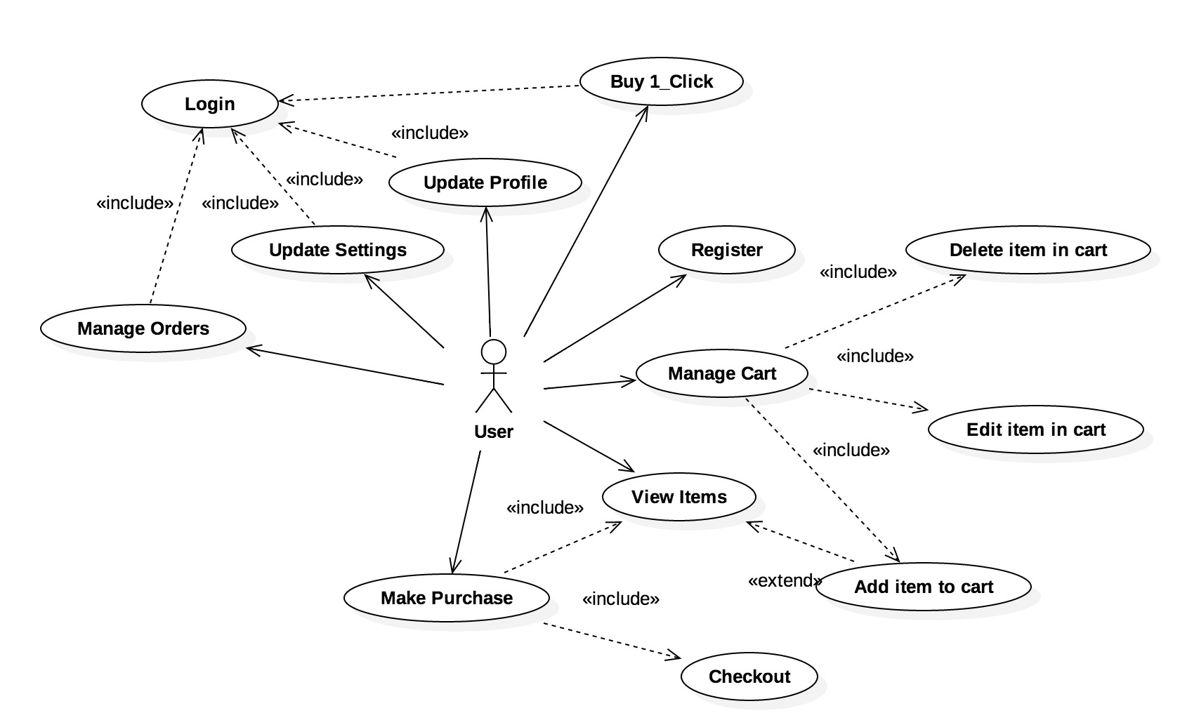
Use cases

Slide 4
technologies
Front-End: JavaFX
Back-End: Java
Database: SQLite

Slide 5
architecture
Presentation Layer: JavaFX
Business Logic Layer (BUS)
Domain Object
Data Access Layer (DAO)
Data Object (DO)
DB Connection
SQLite

Slide 6
Diagrams
Class Diagrams: Domain, BUS and DAO
Sequence Diagrams

Slide 7
demo
Sign up
Login
Choose Product
Manage Shopping Cart
Check Out
Buy 1-Click
Update Profile
View Order History

